Slide 1
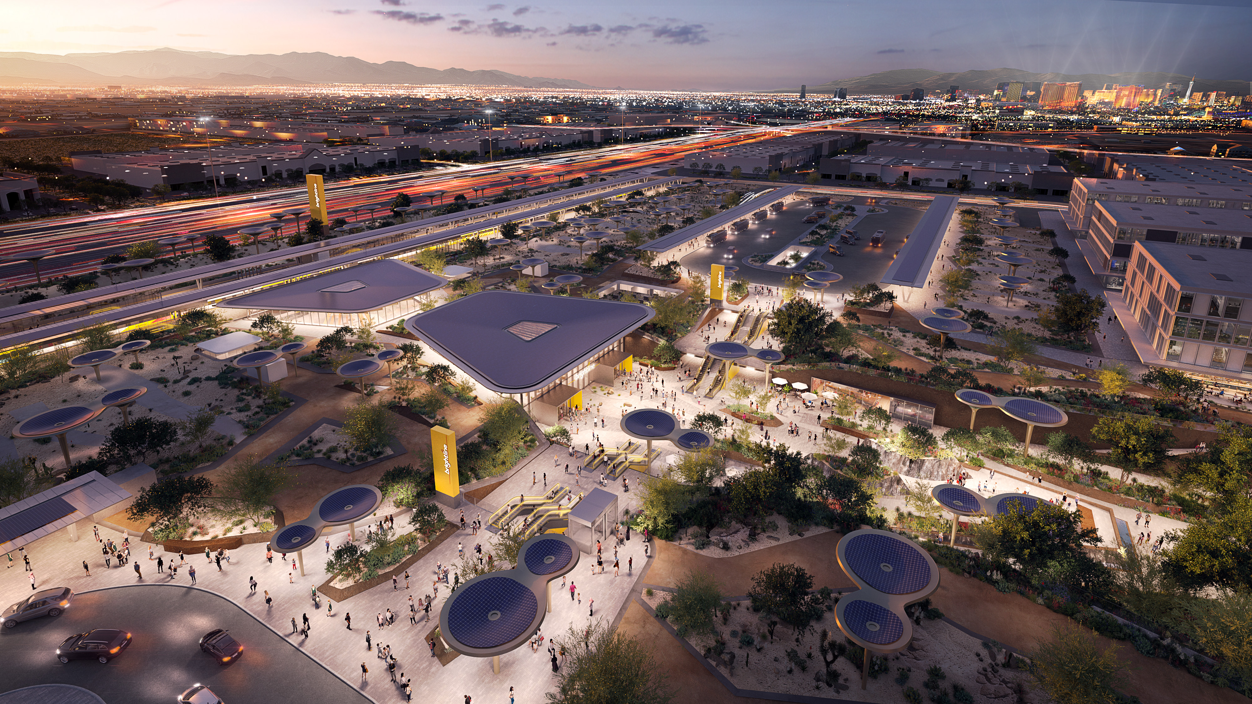
Brightline West Project Update
May 2024

Slide 2

Press next slide for Video

Slide 3
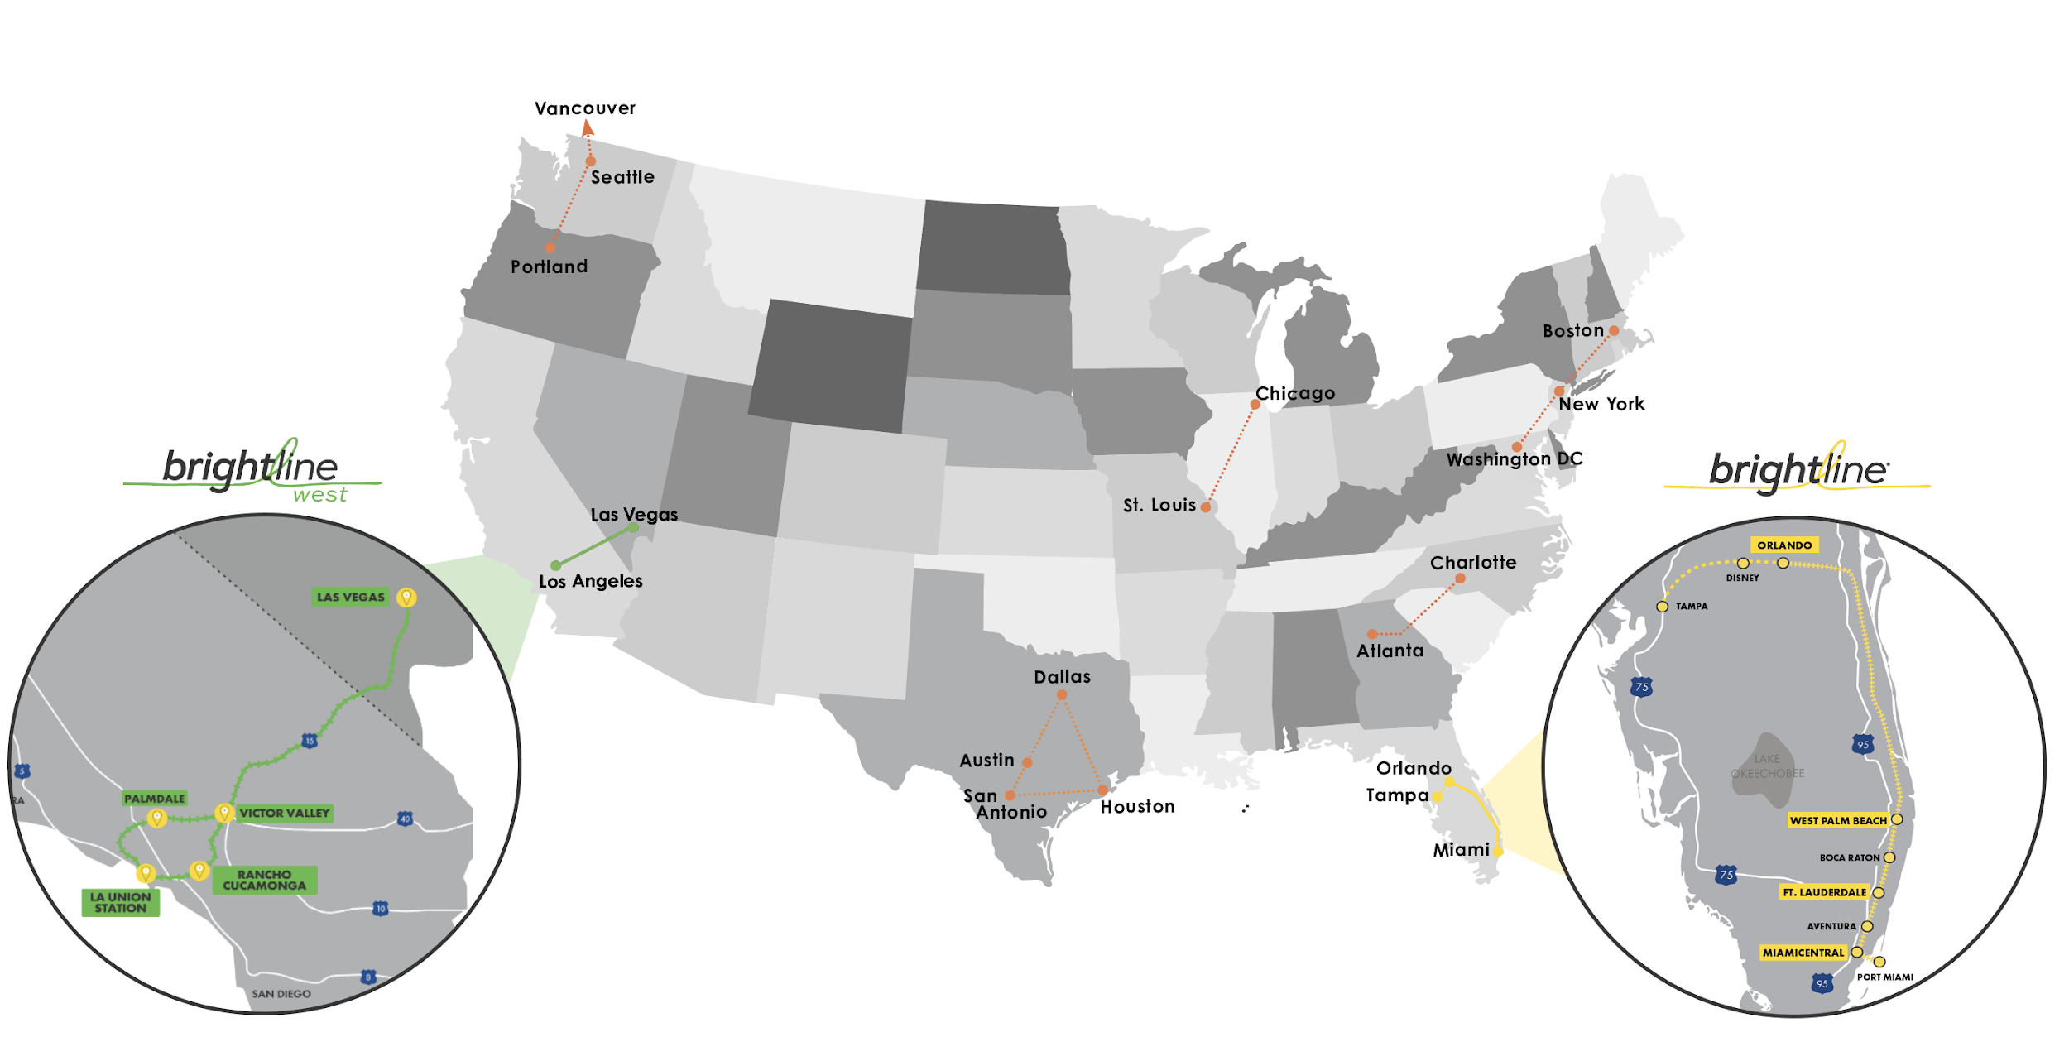
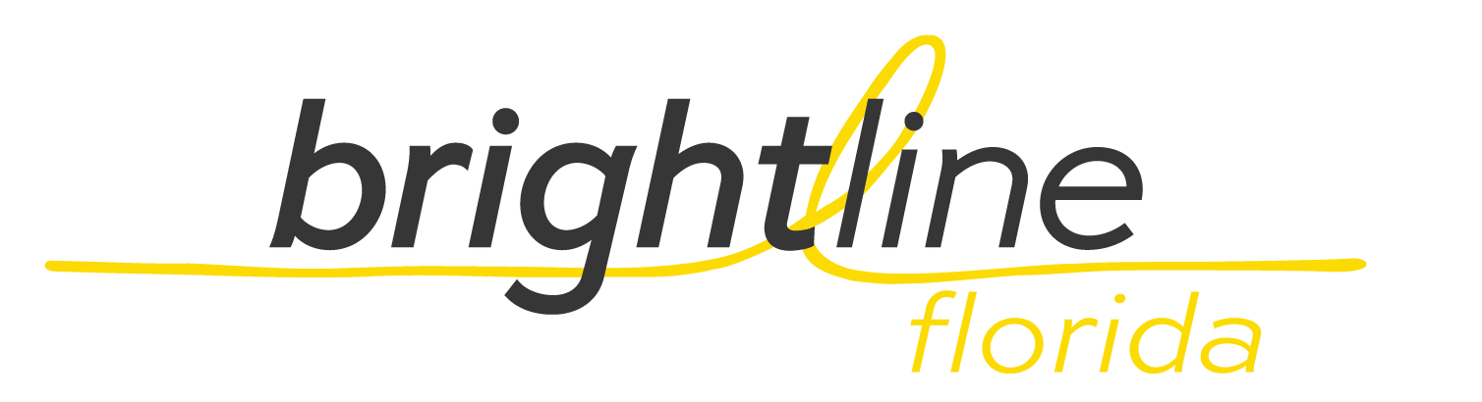
Focused on Bringing Modern, Eco-Friendly Passenger Rail to America
COMPANY GOAL IS TO CONNECT CITY PAIRS THAT ARE
“TOO LONG TO DRIVE AND TOO SHORT TO FLY”

Slide 4
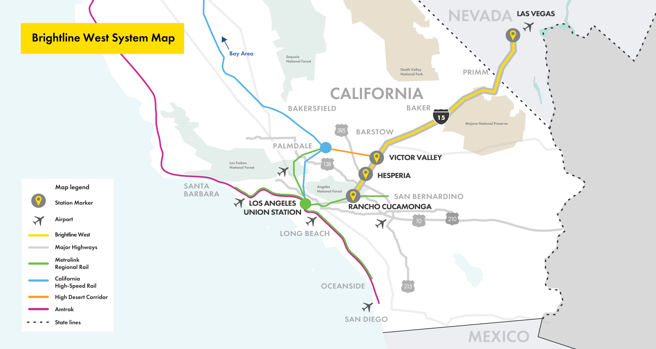
Brightline West - Connecting Las Vegas and Southern California
All-electric trains
in a protected corridor with zero at-grade crossings
218-mile trip
Las Vegas to Rancho Cucamonga
Up to 200 mph
true high-speed rail
+11 million
one-way passengers/year

Slide 5


Brightline West Benefits
Plants the Flag for True American High-Speed Rail
There are many “too long to drive, too short to fly” city pairs in U.S.
Start of high-speed train “industry” in America
Blueprint spurring more systems to be built
Creating High-Quality, Good-Paying Jobs
Project will generate $10B+ in economic impact
10K+ field jobs during construction
1,000 permanent operations & maintenance jobs
Green & Safe
Emission-free trains & power result in 400K ton annual CO₂ decrease
Equal to 3M cars off the road + 16K short-haul flights not flown
Also results in large reduction in highway-related deaths & injuries
CO₂

Slide 6
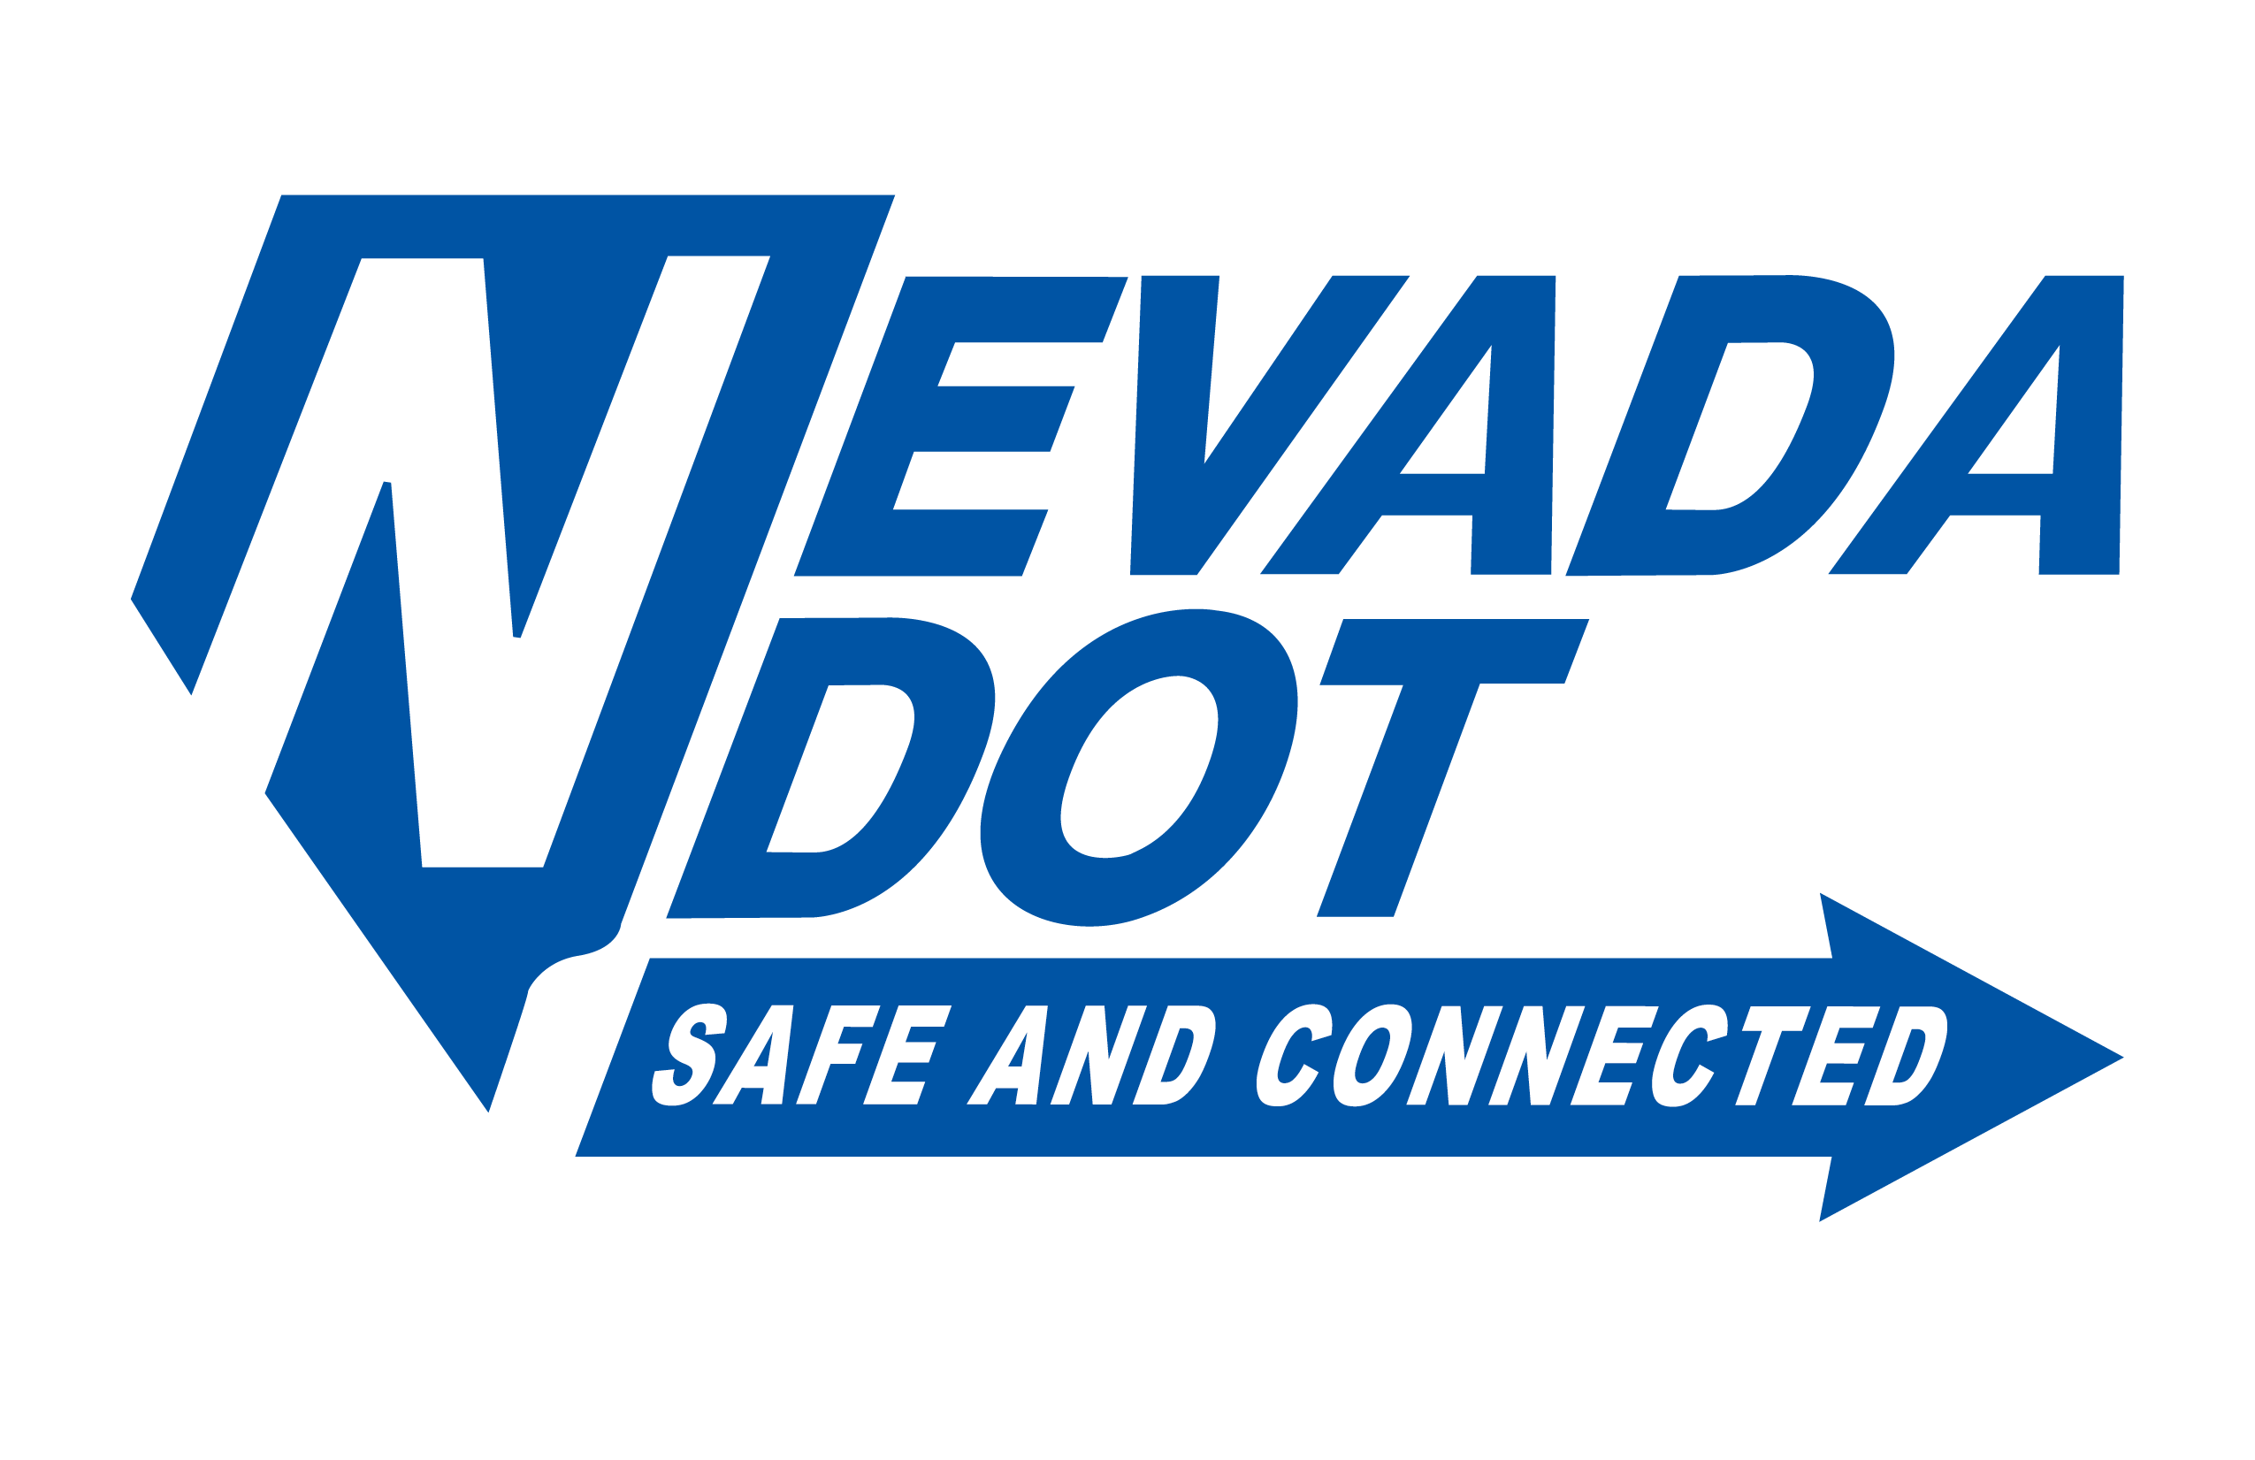

Federal Railroad Administration
NEPA, corridor safety, and rolling stock regulations
Surface Transportation Board
STB certification
Federal Highway Administration
NDOT & Caltrans
NEPA & agreements for ROW, D&C, and O&M
Railroads & Utilities
UPRR & BNSF, as well as utilities like SCE, LADWP, and NVE
Key Stakeholders
Fed-State Partnership Agreement
Bureau of Land Management
Land for CA substations and limited NV parcels including VMF
Apple Valley to Rancho Cucamonga
SBCTA, City of Rancho Cucamonga, and LAUS/Metrolink
+

Slide 7
Concept of Operations - Overview
PRIMARILY SINGLE-TRACK RAILROAD WITH PASSING SIDINGS
Total Single-Track Miles | 180.4 | 83%
Total Double-Track Miles | 37.4 | 17%
Total Miles | 217.8 | 100%

Slide 8
Typical Sections
SINGLE TRACK
DOUBLE TRACK

Slide 9
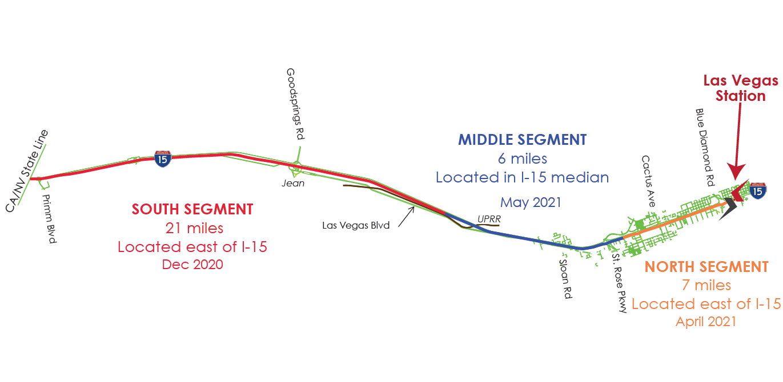
Rail Alignment
In California, primarily median running. In Nevada:
Median running for Middle Segment – 6 miles
Median running at State Line through South Segment
– 21 miles
East-side running for North Segment – 7 miles
Vehicle Maintenance Facility

Slide 10
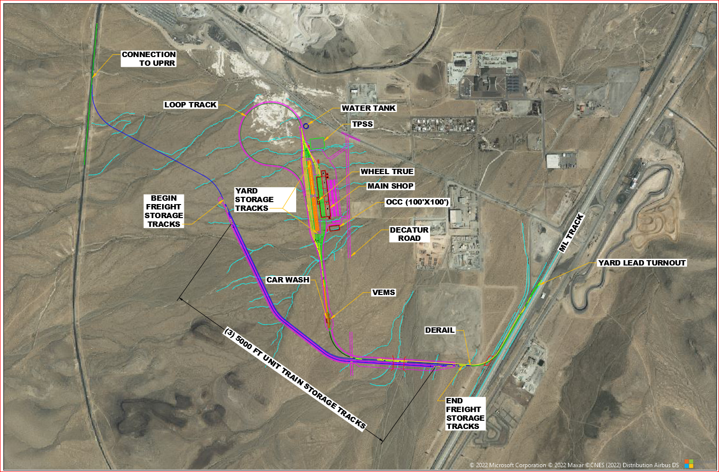
Planned Maintenance Facility (Depot) Site
I-15 and Sloan Interchange

Slide 11
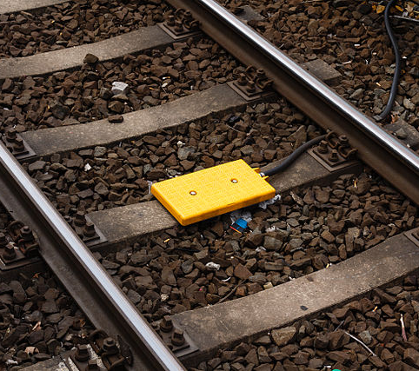
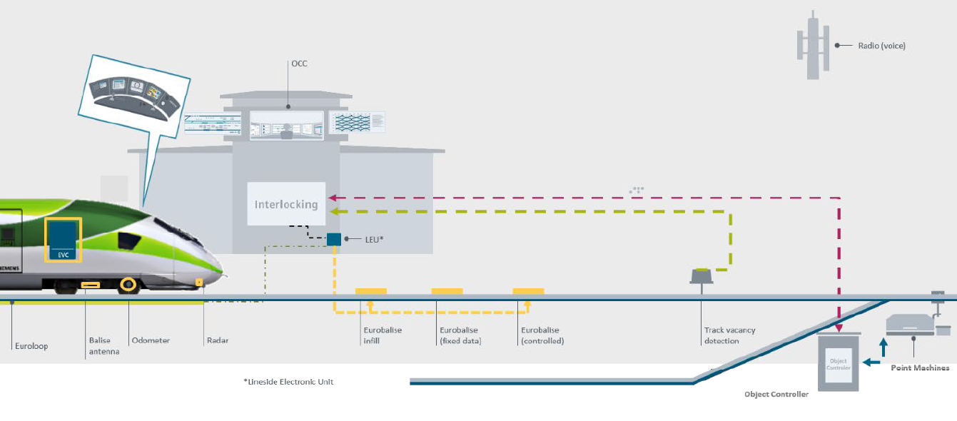
European Train Control System (ETCS)
Train Control (Signaling)

Slide 12
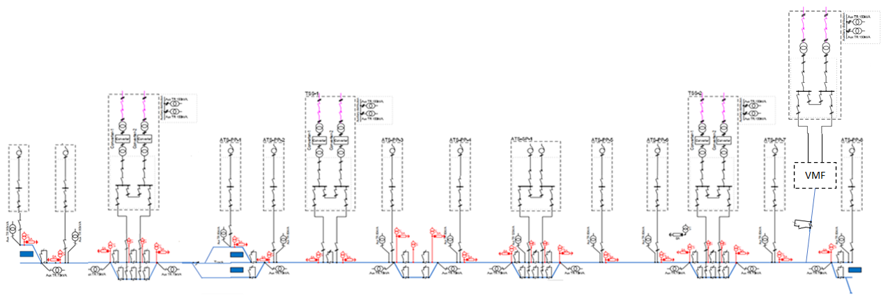
Power Supply
Feed in Sites – Location of Traction power substations
ATS Sites – Voltage boosting to maintain Traction power voltage
VMF
Tortilla Kramer
Hesperia
Ivanpah
Rancho
Victorville
Las Vegas

Slide 13
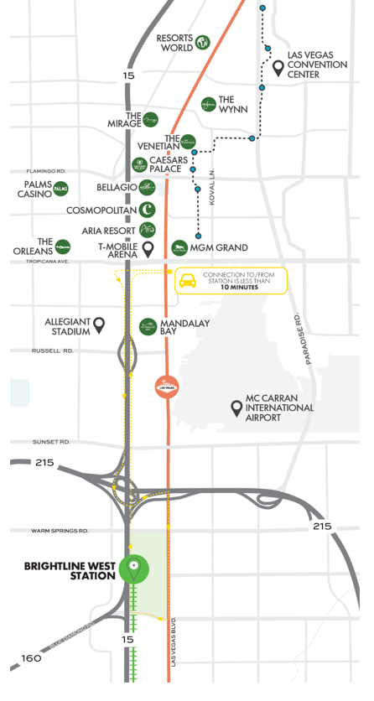
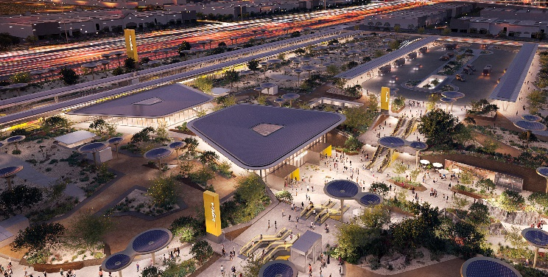
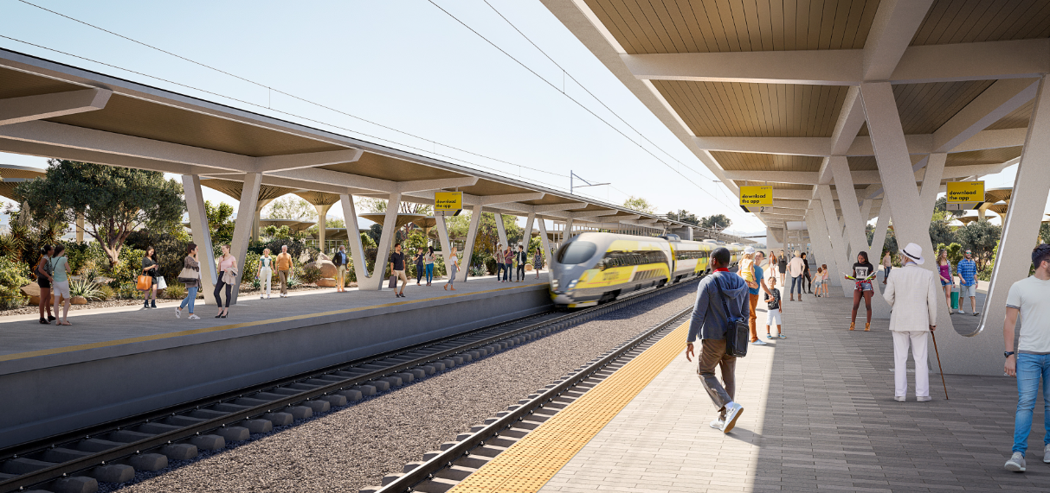
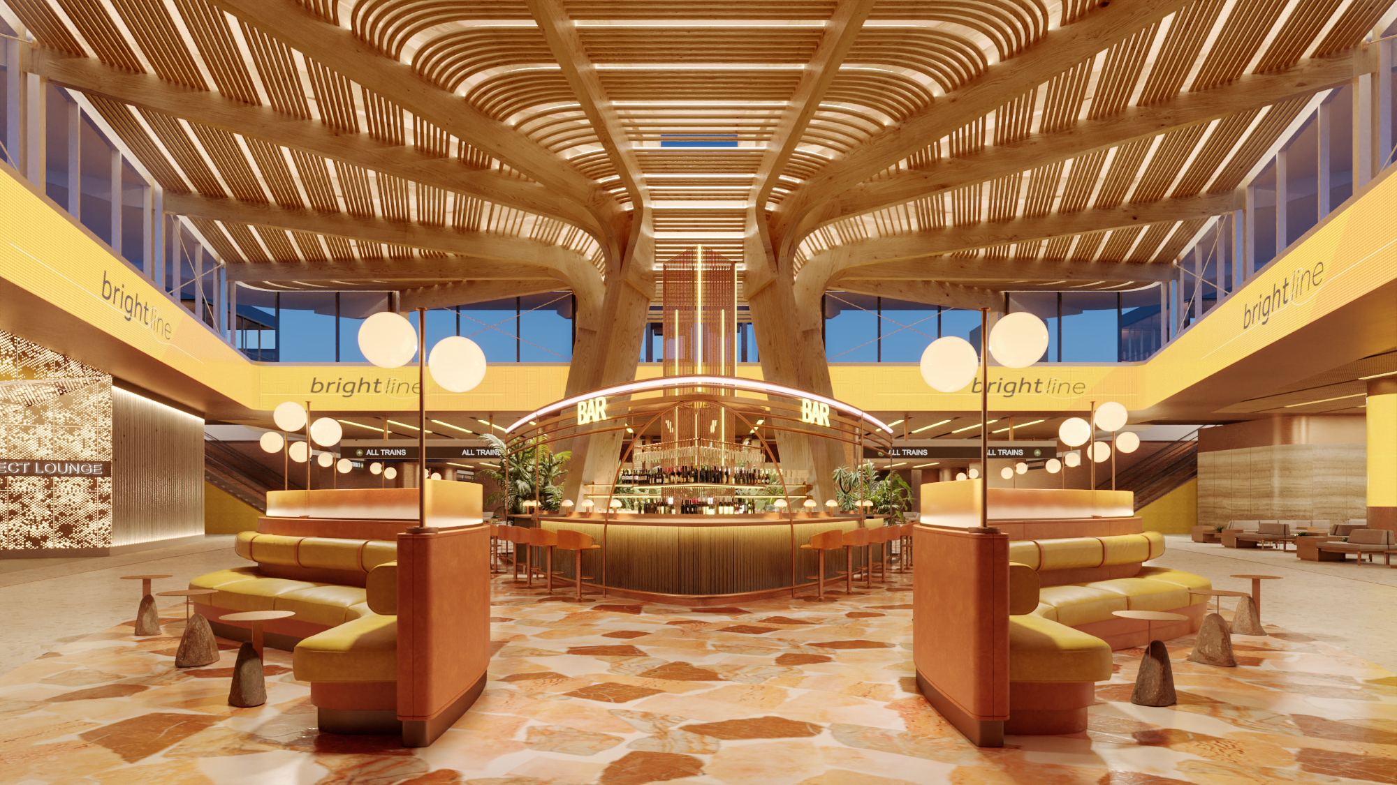
Las Vegas Station
Las Vegas station aerial
Station exterior
HARRY REID INTERNATIONAL AIRPORT
Station interior

Slide 14
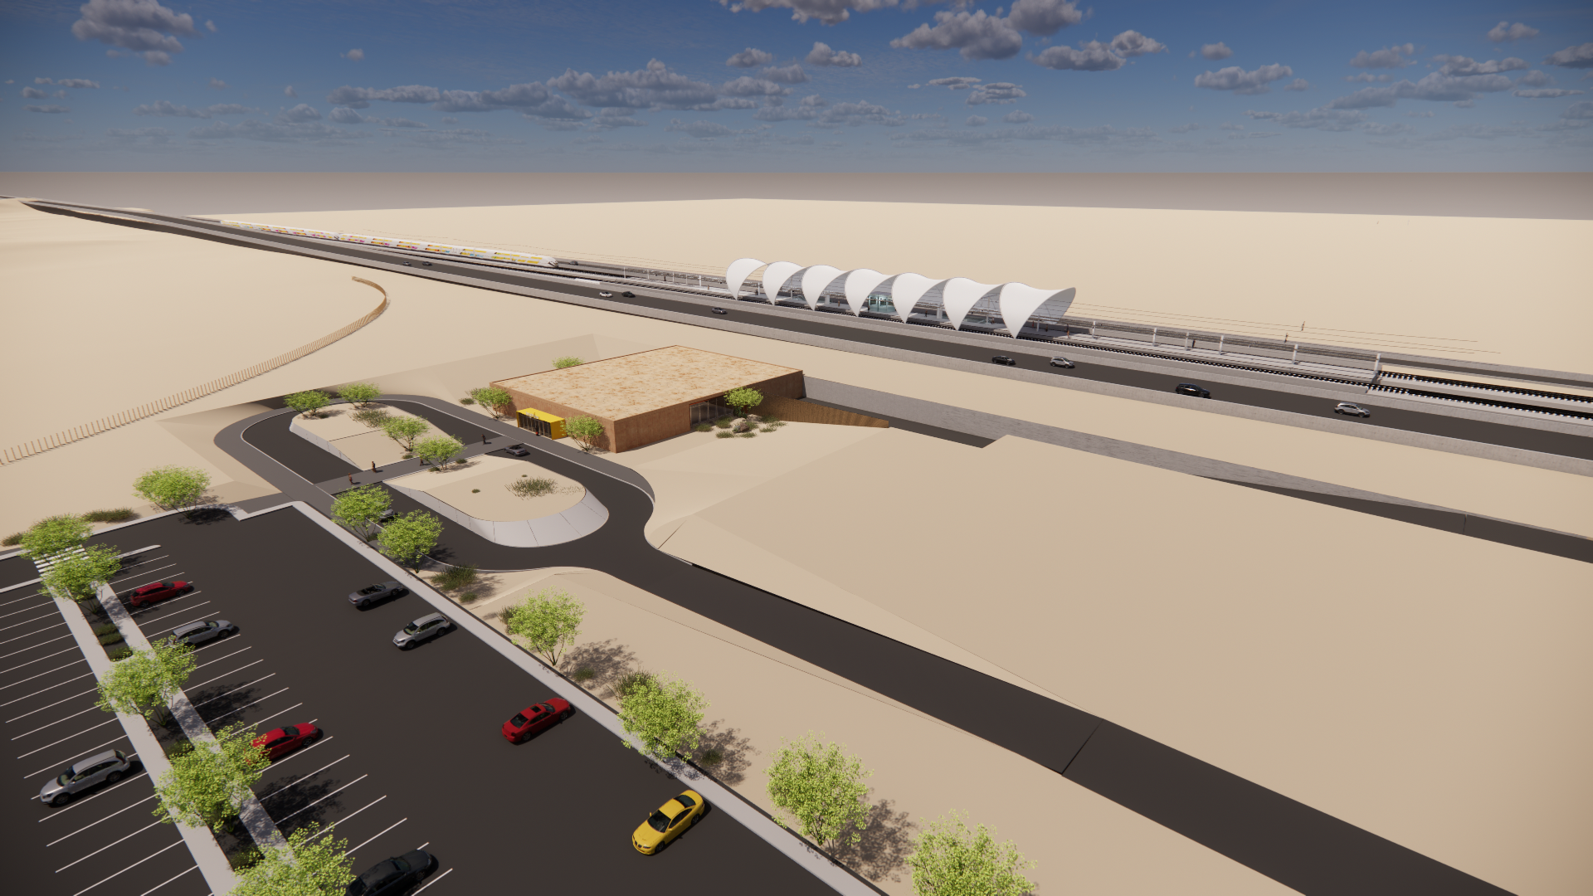
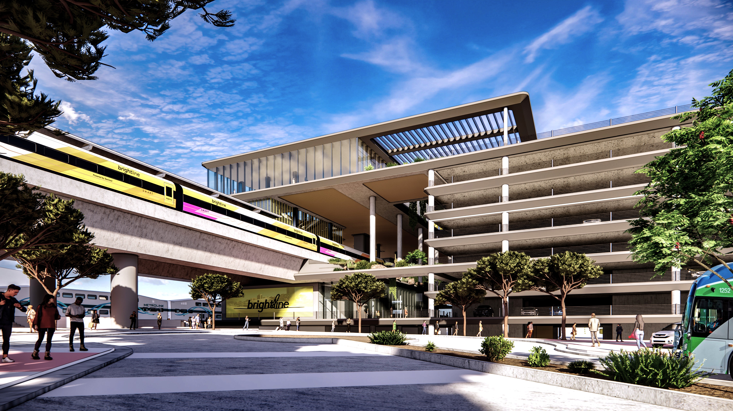
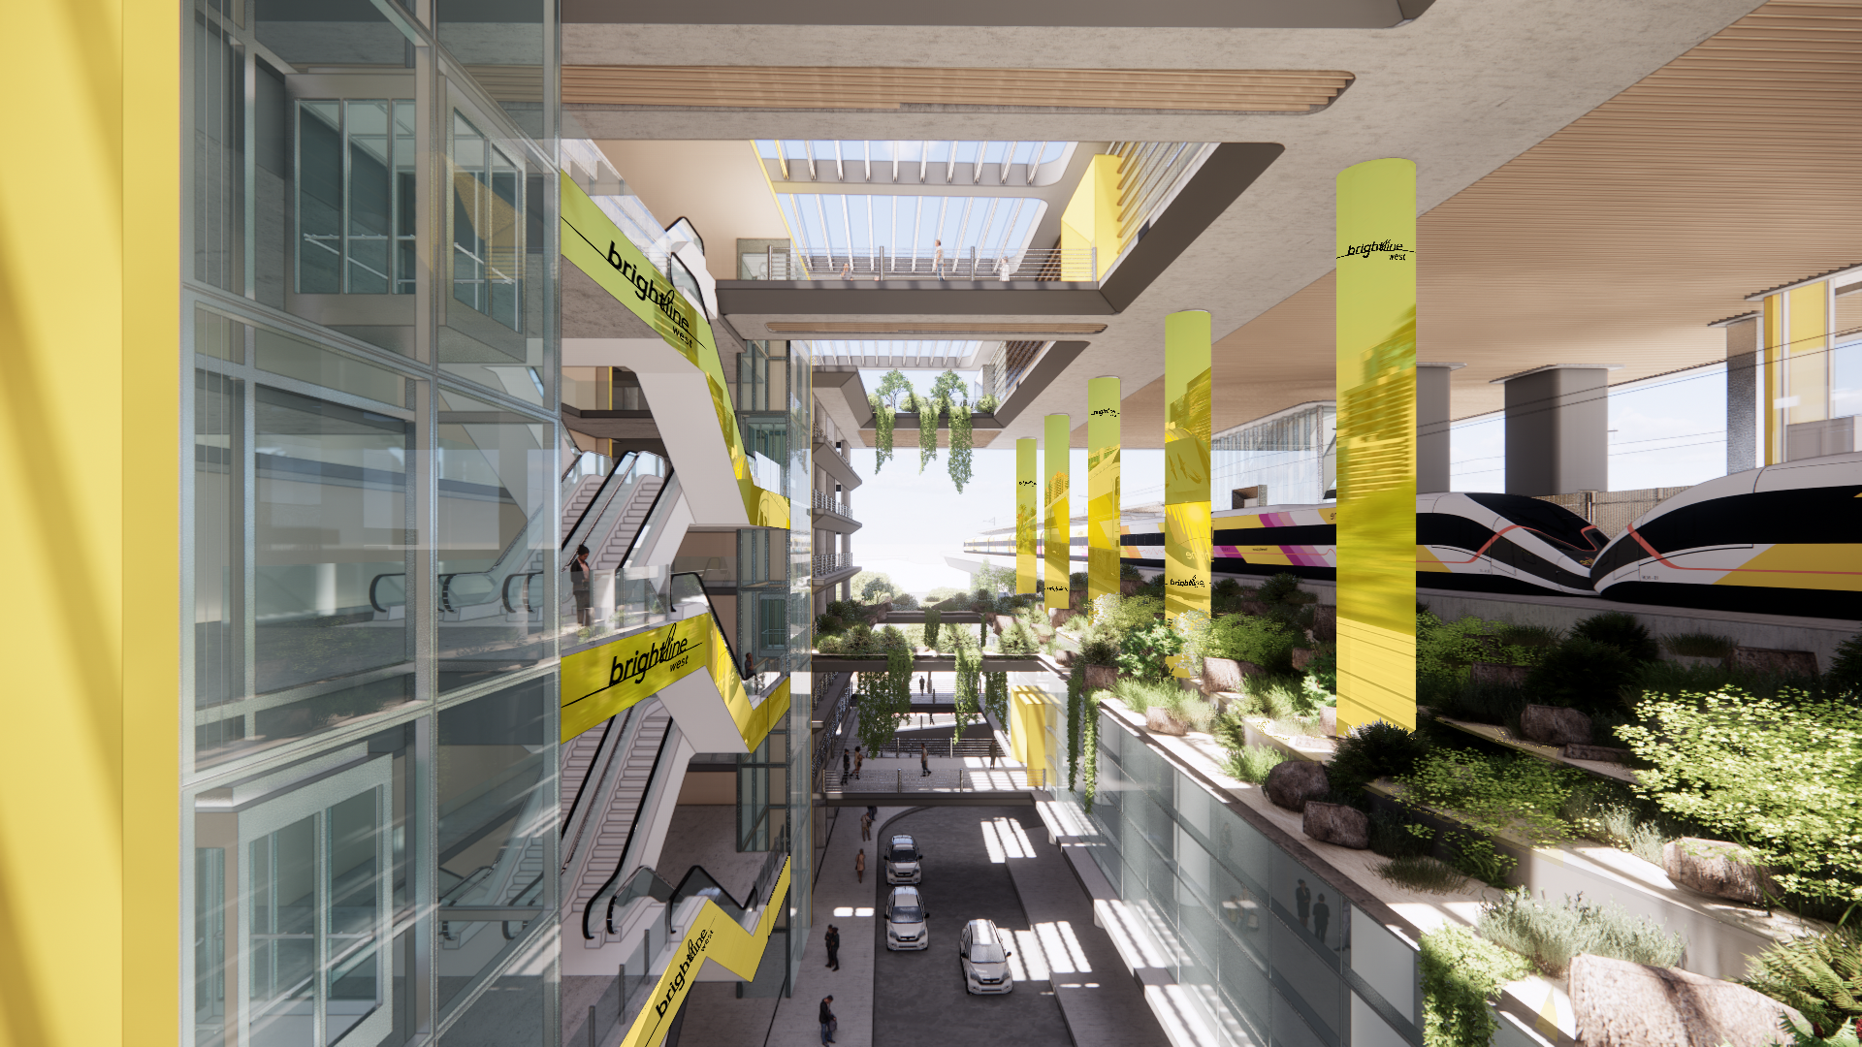
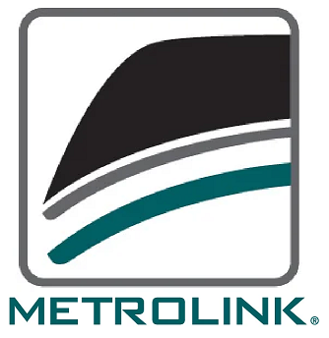
California Stations
Victor Valley (similar Hesperia) in-line station
Rancho Cucamonga station
Rancho Cucamonga station
COORDINATION WITH METROLINK
TIMETABLE SCHEDULING
SEAMLESS TRANSFERS
TICKETING
BRANDING

Slide 15
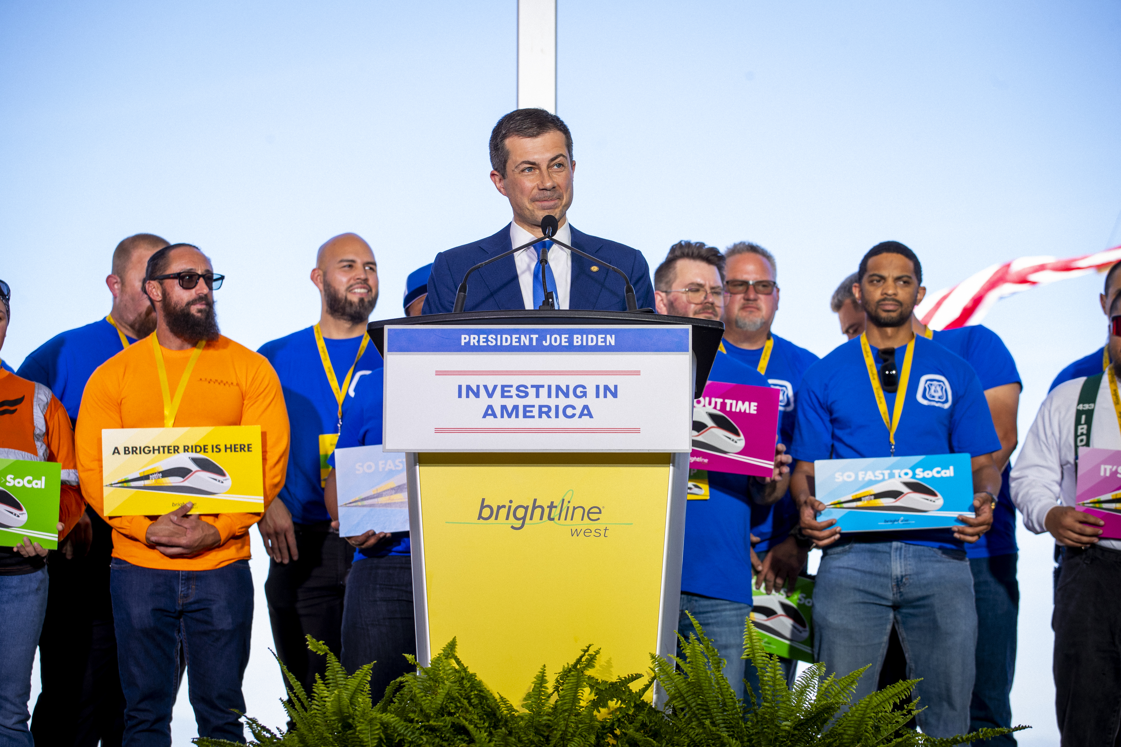
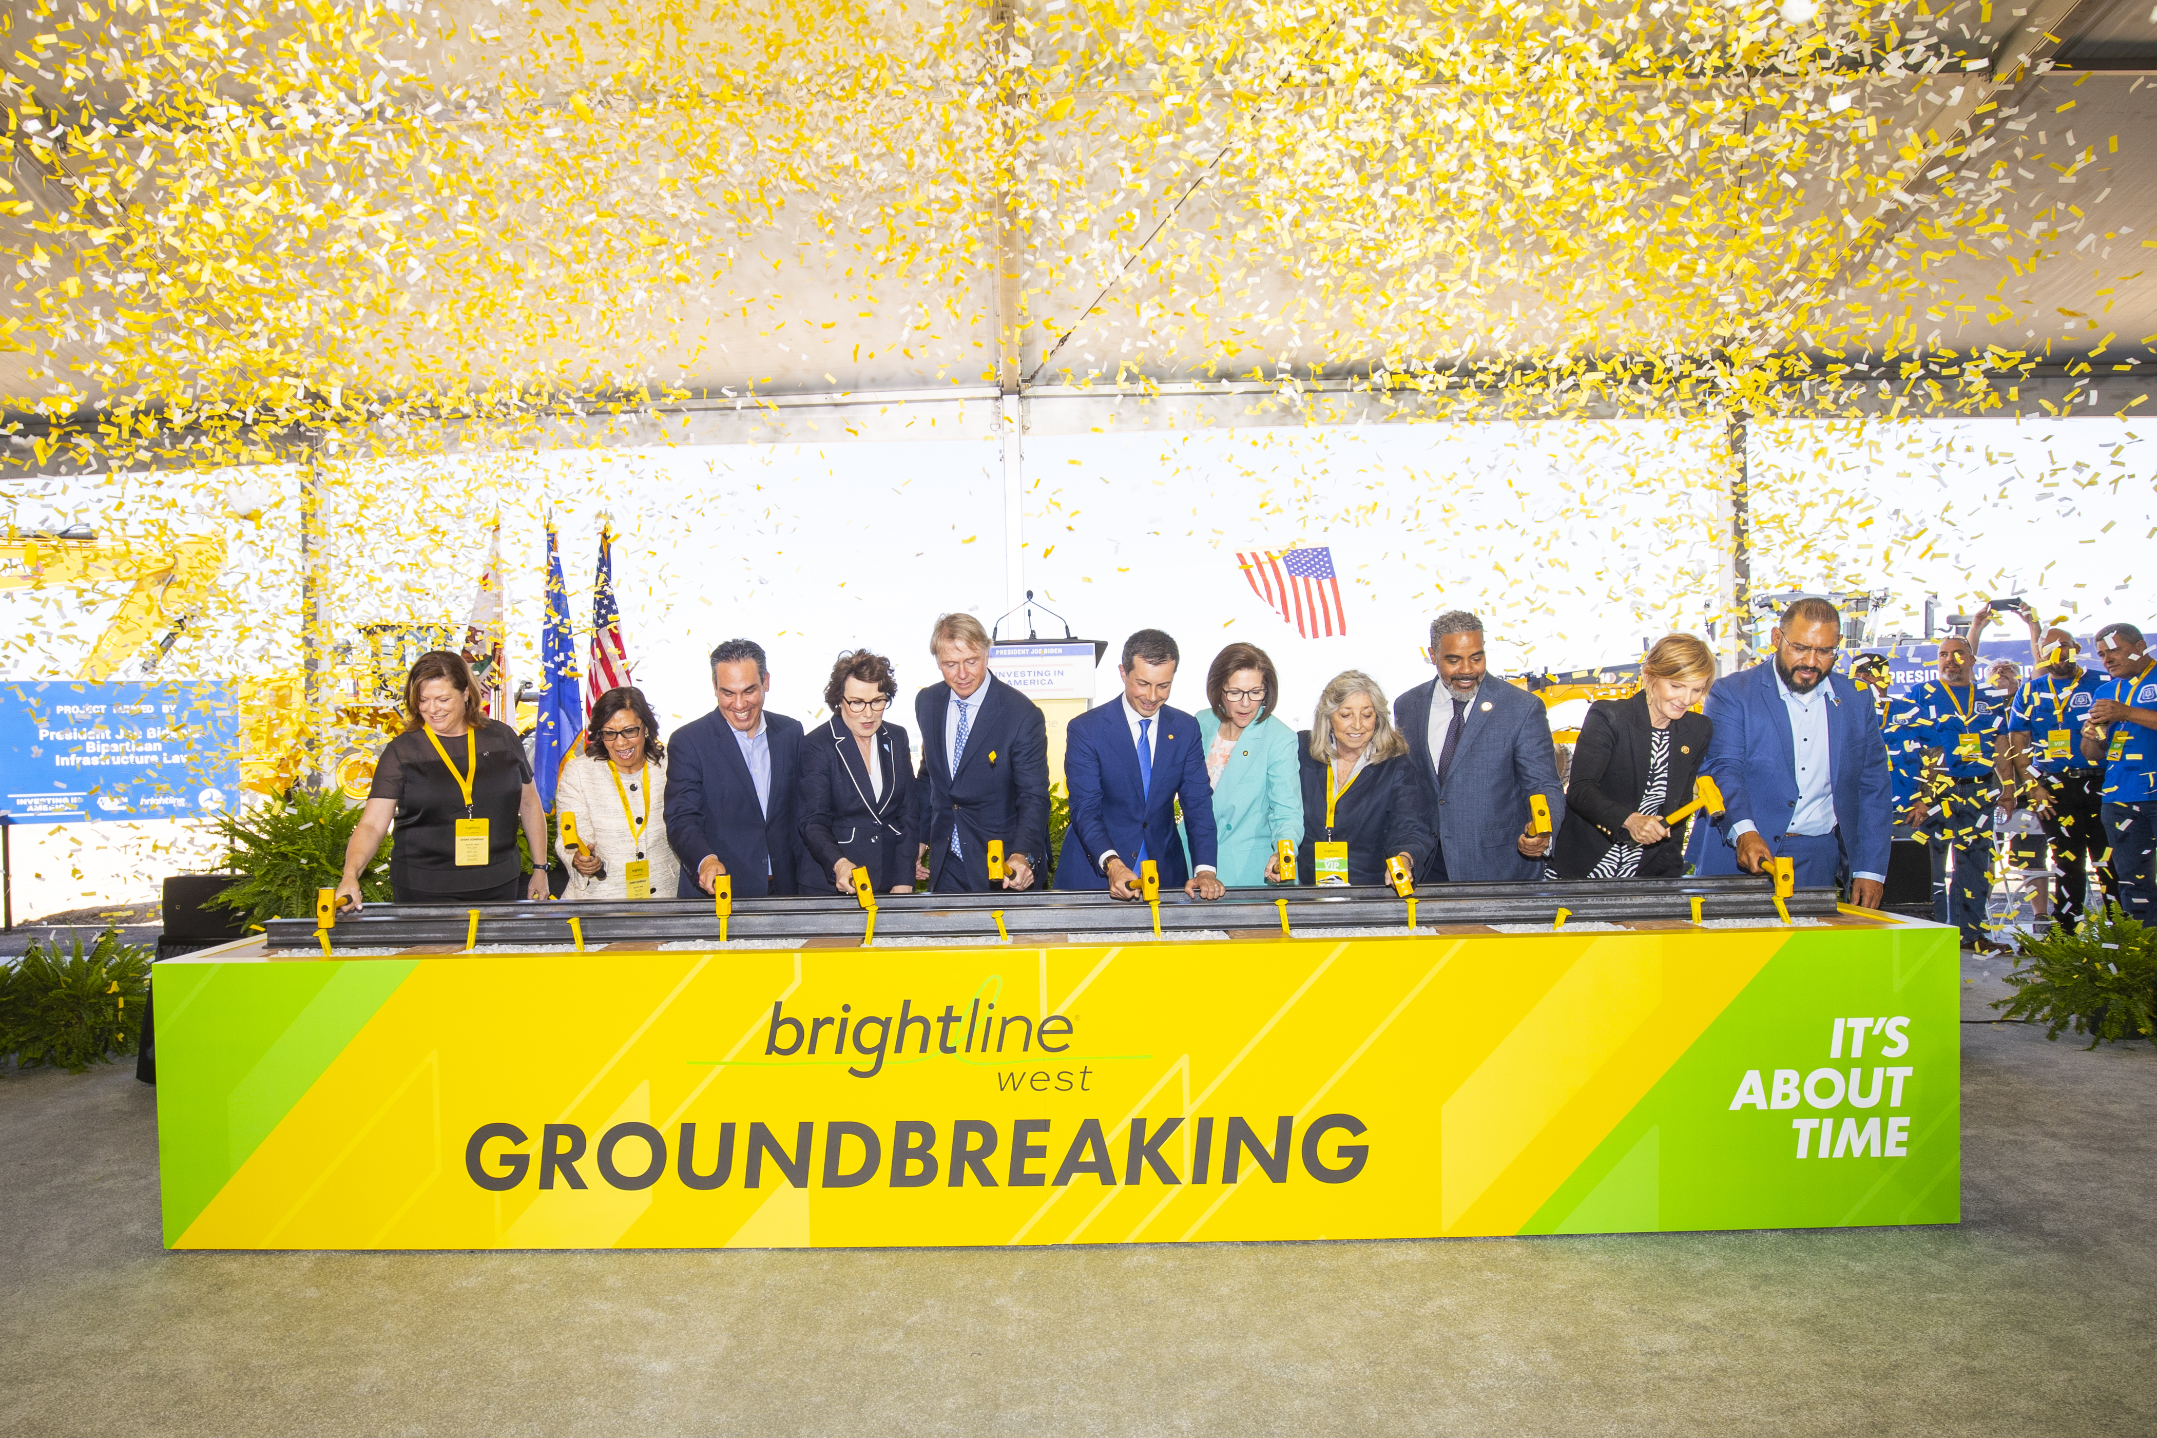
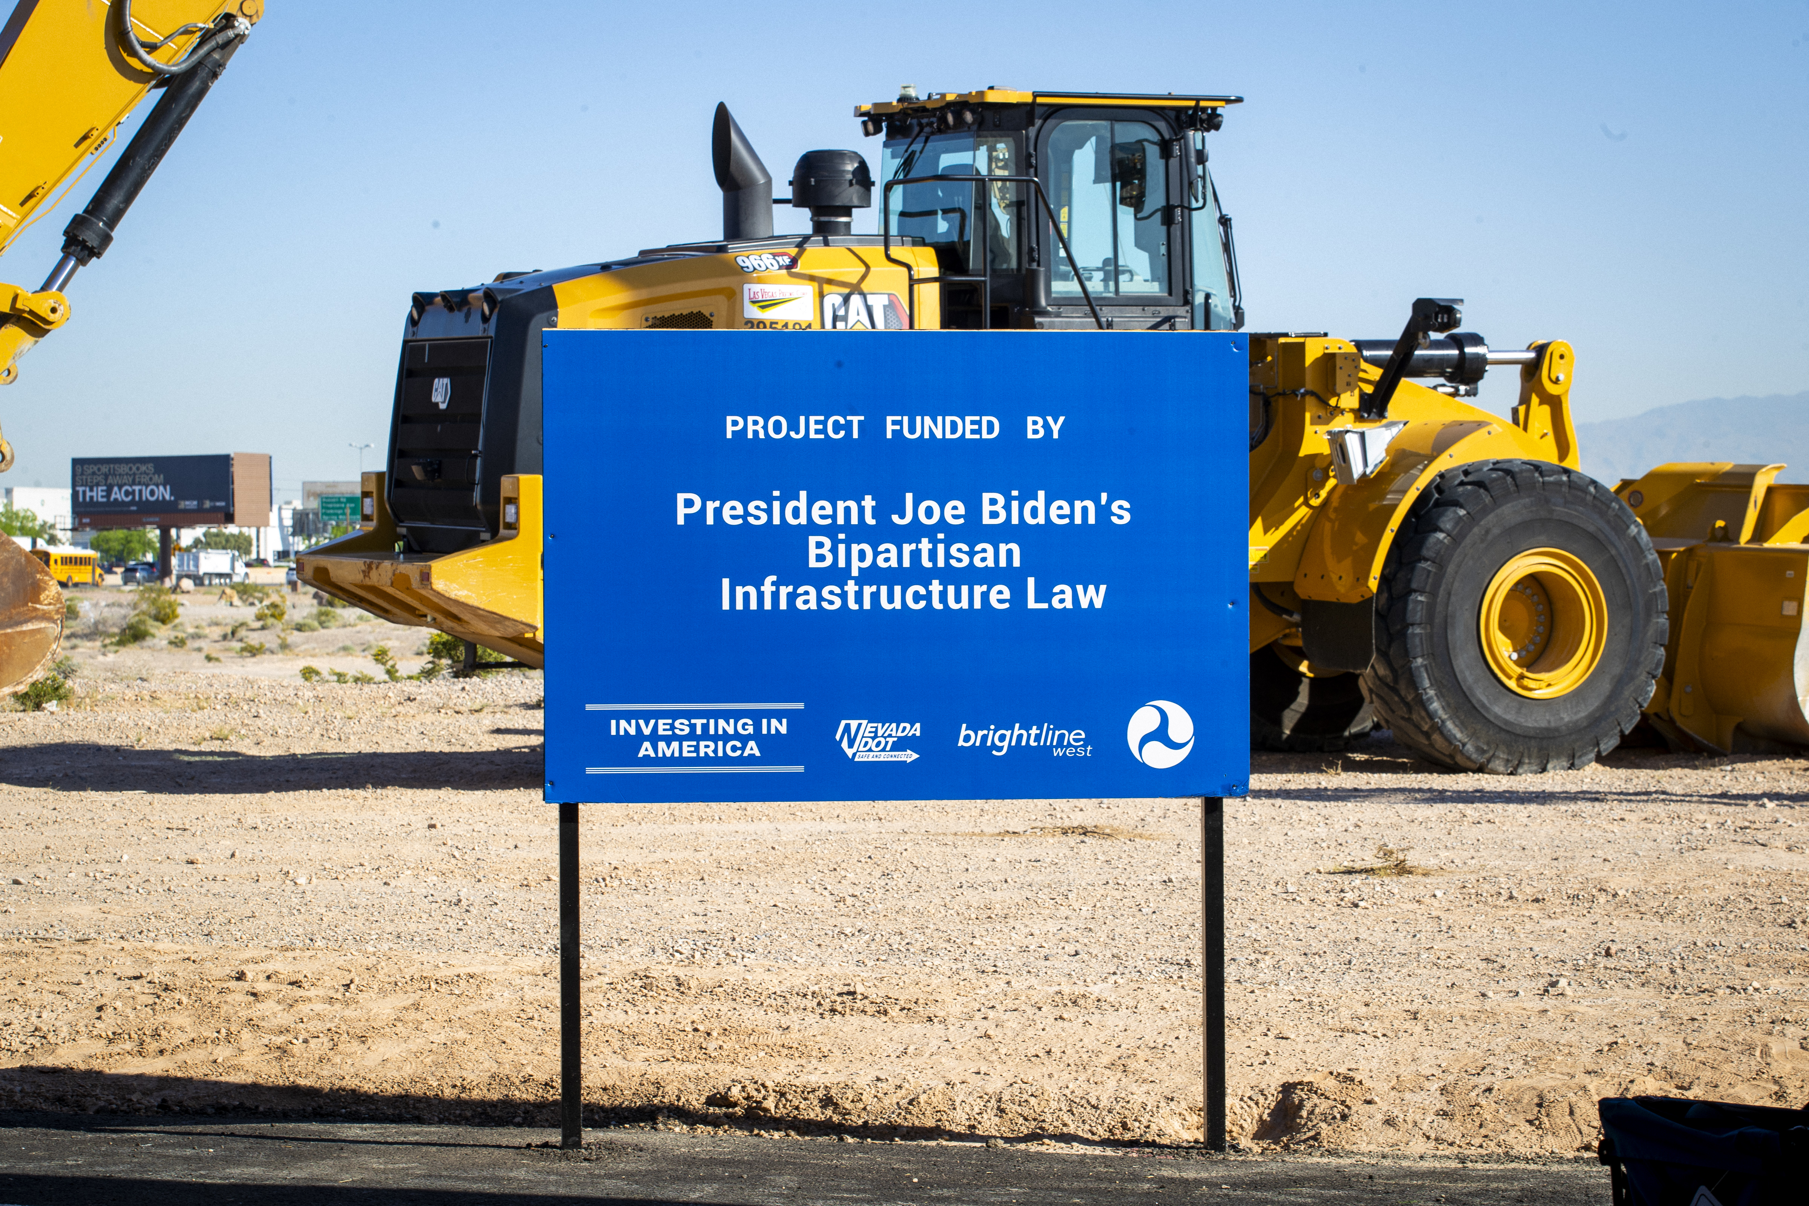
Groundbreaking – April 22, 2024

Slide 16




Positioned for Service in 2028
  $12B project, mostly to be funded by private dollars
  Already invested ~$600M
  Awarded $3B federal grant through NDOT
  Received $25M RAISE grant through SBCTA for Hesperia and Victor Valley Stations
  Open in ~4 years
+
  Land &
  rights of way
  Permits
  Construction readiness

Slide 17

Contact Us
For subcontracting & vendor opportunities, please email us at outreach@brightlinewest.com with your:
Company contact information
(i.e., name, phone number, email address, website)
Company line of business
Minority business certifications
Preferred operating geography

Slide 18
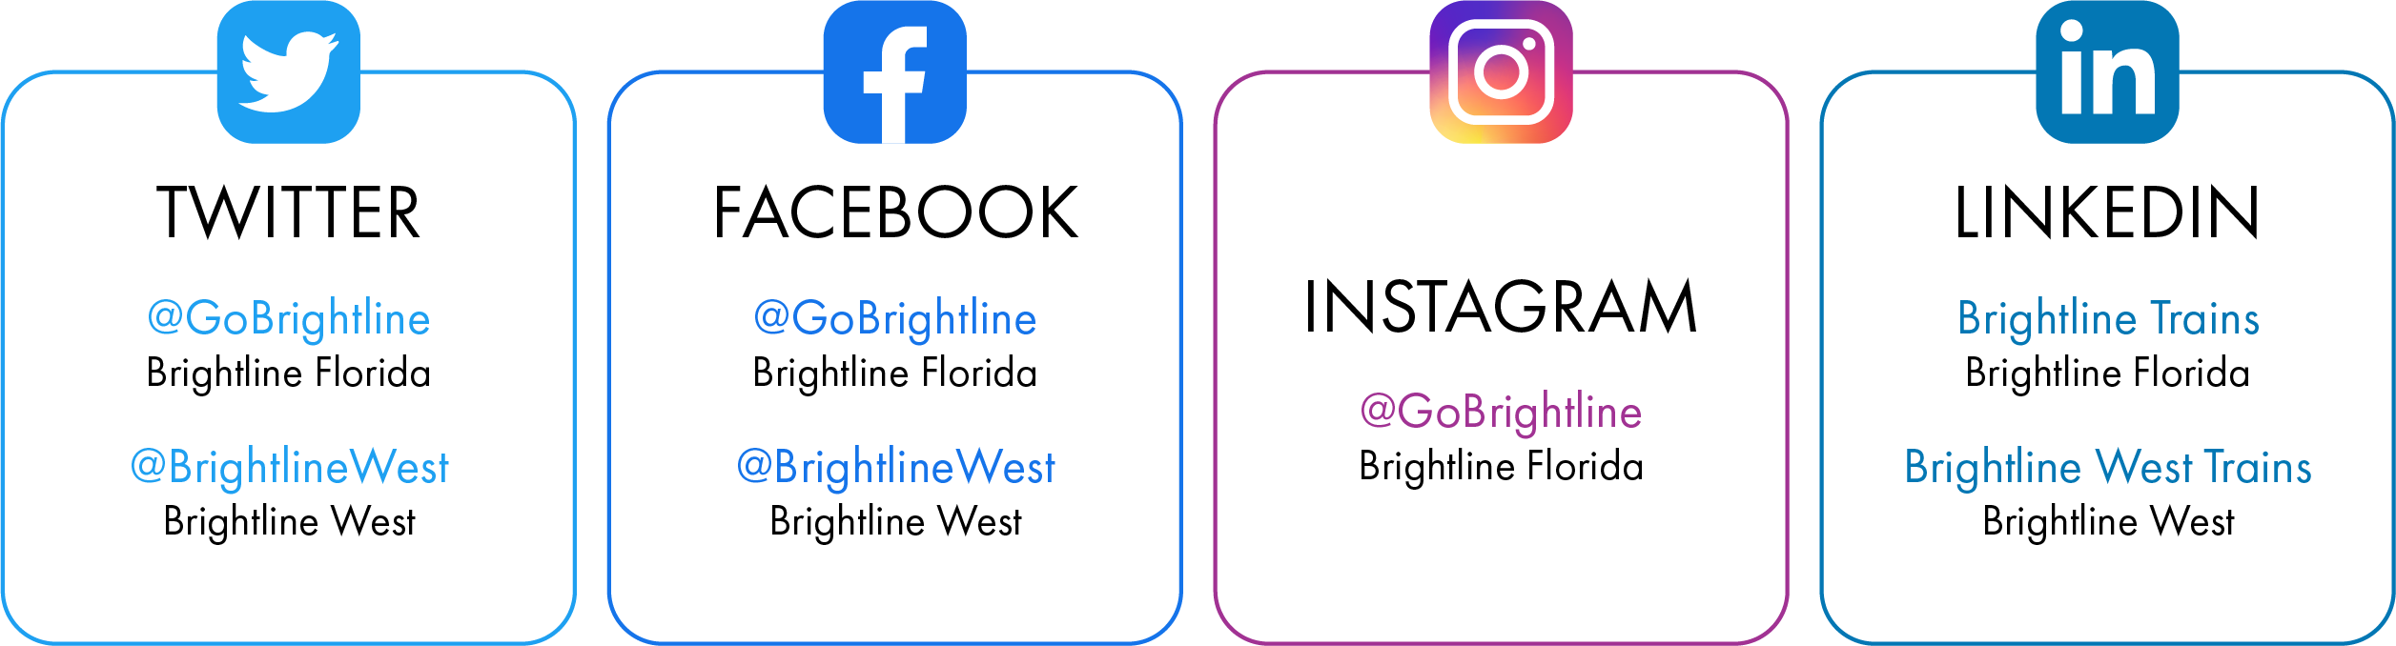
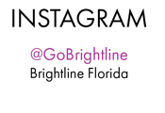
THANK YOU
Follow Us
@RideBrightlineWest

